Slide 1

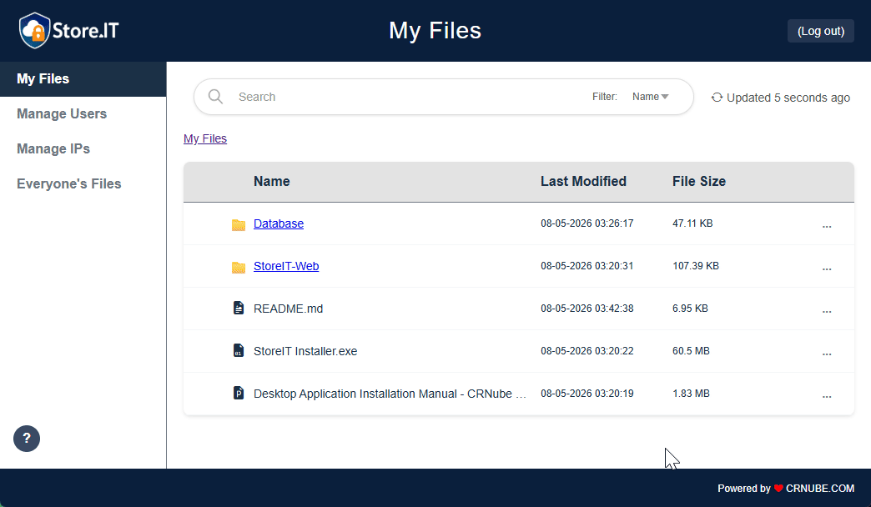
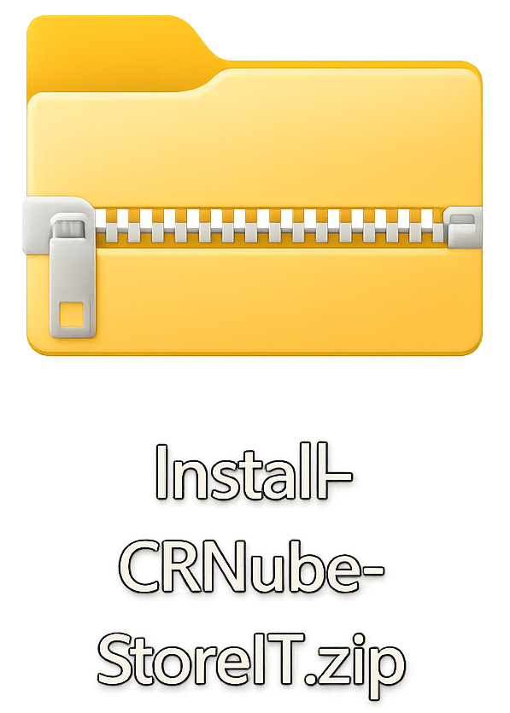
StoreIT Web Installation
Manual for Virtualmin

Slide 2
Requirements:
In addition to the installation ZIP file, named Install-CRNube-StoreIT.zip, you will need:
Hosting environment with:
Apache as the web server.
PHP 7.4+ (or compatible with PHP 8.x).
MariaDB (or compatible with MySQL).
External service accounts (free plans available):
Mailjet: required for sending transactional emails (account activation, password recovery, etc.).
hCaptcha: required for bot mitigation in password recovery and two-factor authentication reset forms.
Although this manual uses Virtualmin as the web hosting control panel, a different one can be used as long as it meets all the aforementioned requirements.

Slide 3
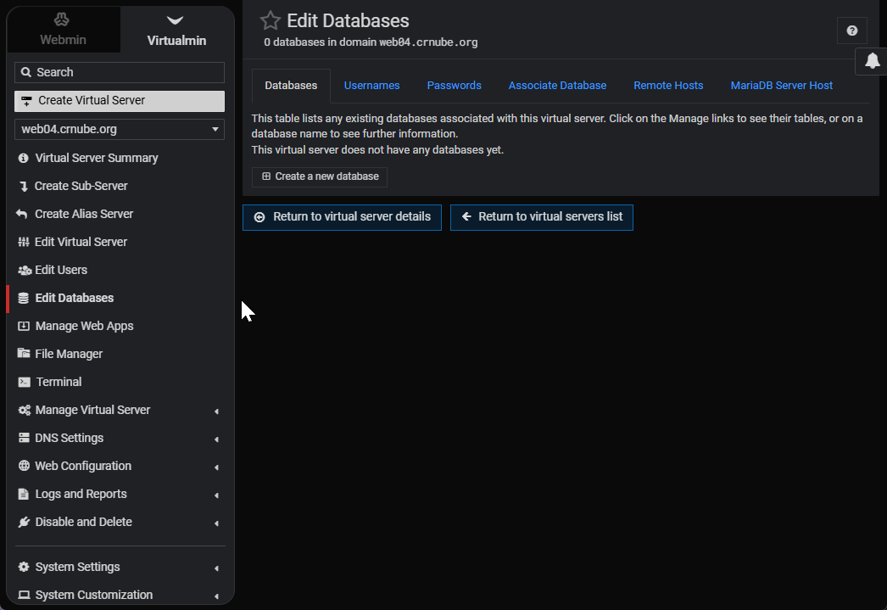
Before you start:
It is necessary to create the database and its credentials, as these are required for the initial application setup. The video shows how to do this in Virtualmin.

Slide 4
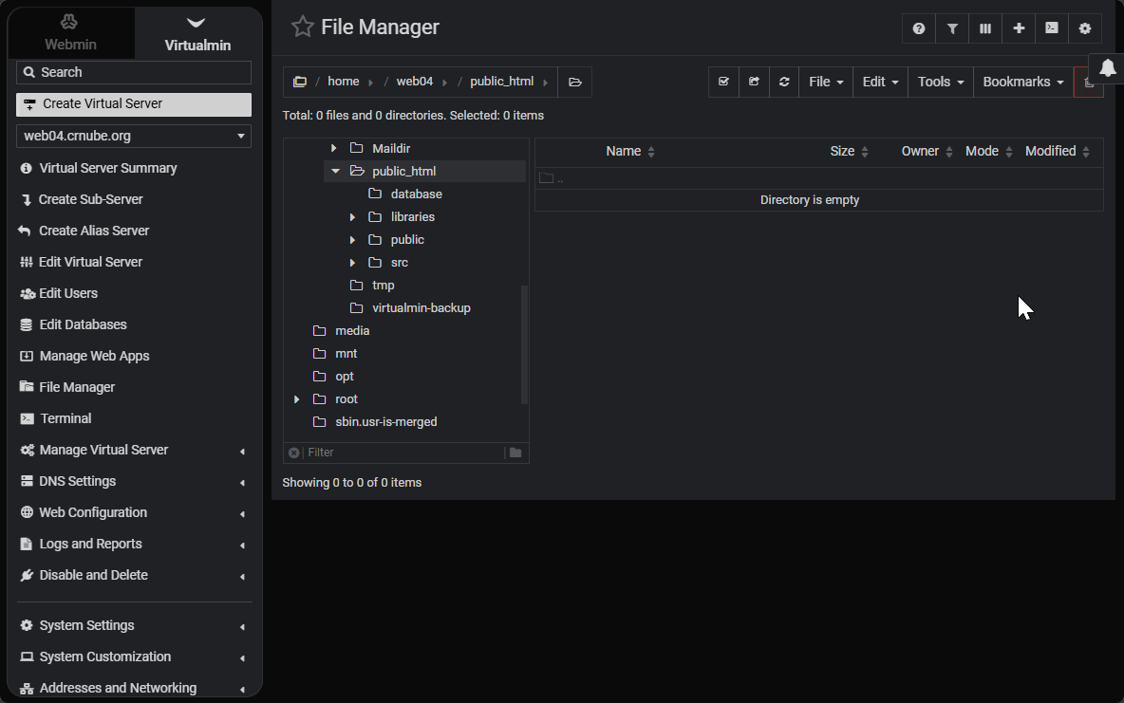
Step #1
In your hosting control panel, navigate to the location where you want to install the application. Then, upload the zip file there and extract it. The video shows how to do this in Virtualmin.

Slide 5
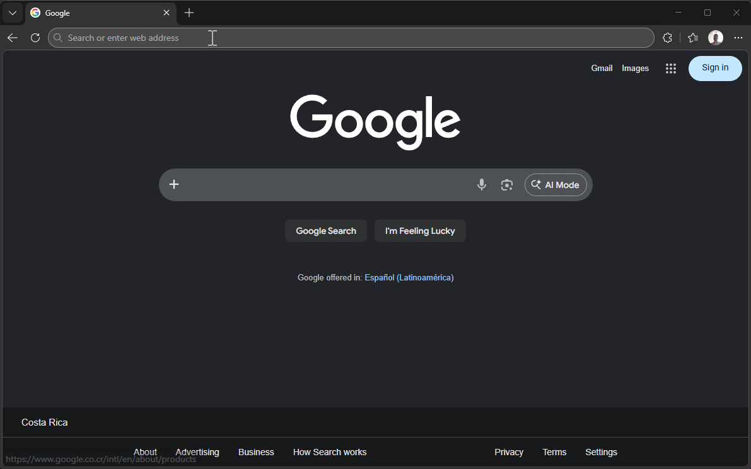
Step #2
Use your preferred browser to navigate to the URL corresponding to the application's installation path on your hosting. You should see a page titled Initial Setup (/setup).

Slide 6
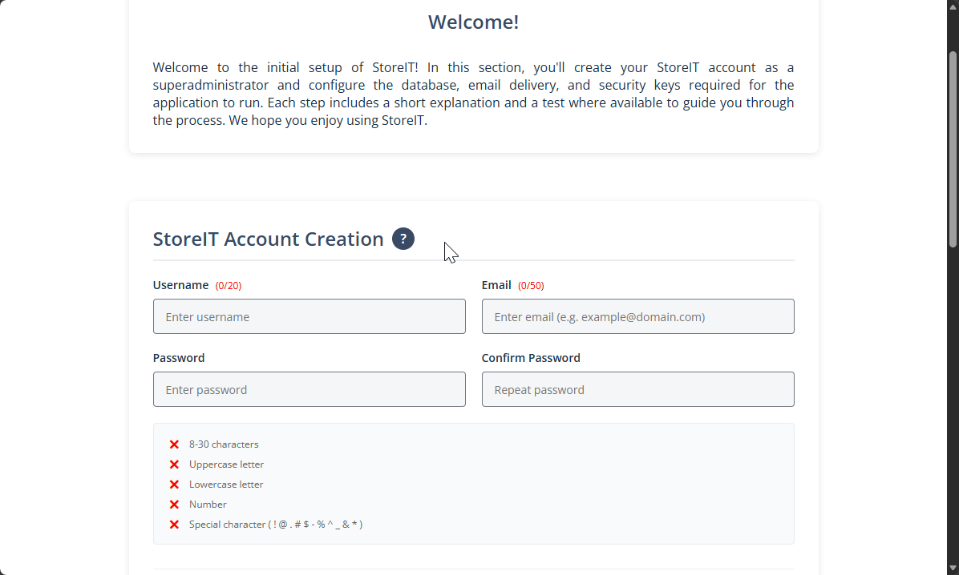
Step #3
Create your StoreIT account credentials following the format restrictions shown in the Help and the password checklist.

Slide 7
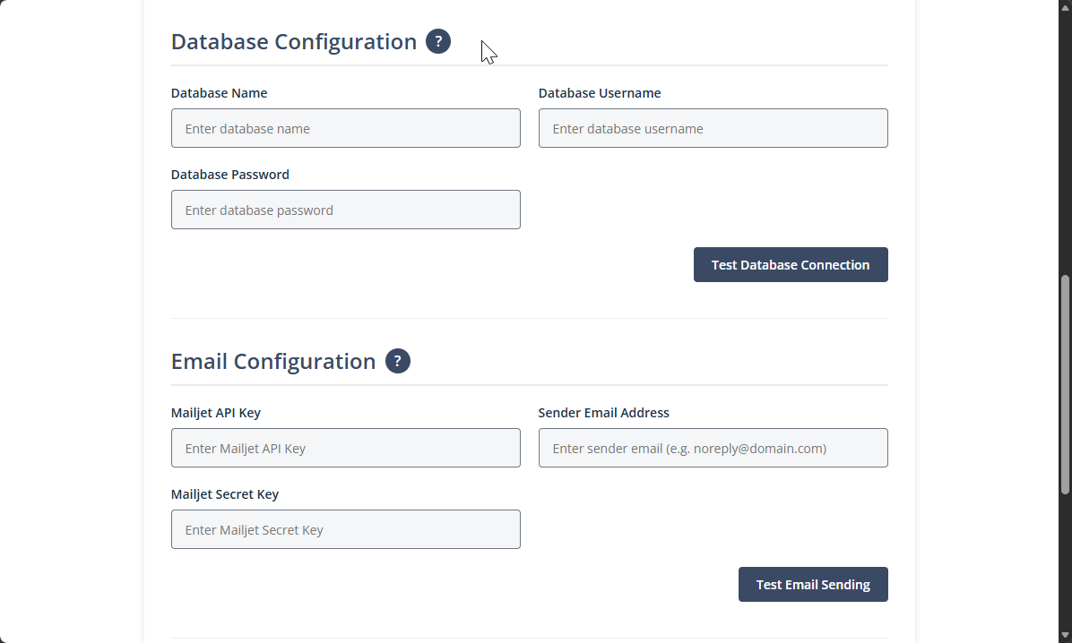
Step #4
Enter the credentials for the MariaDB database created for this app. Then, click the test button to verify the DB connection.

Slide 8
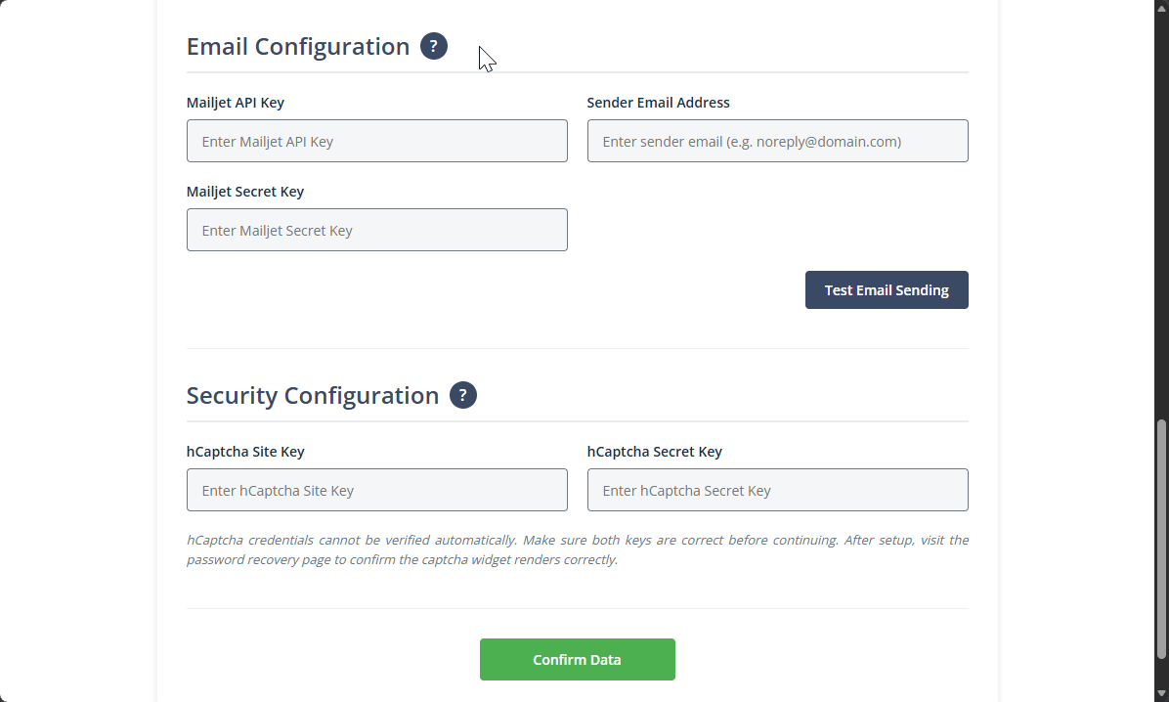
Step #5
Open Mailjet and copy the credentials needed to configure the email sending. You can use the Help button for more information. Once you have filled in the fields, test sending an email and please verify that it is received correctly before continuing (even if the app says the email was sent successfully).

Slide 9
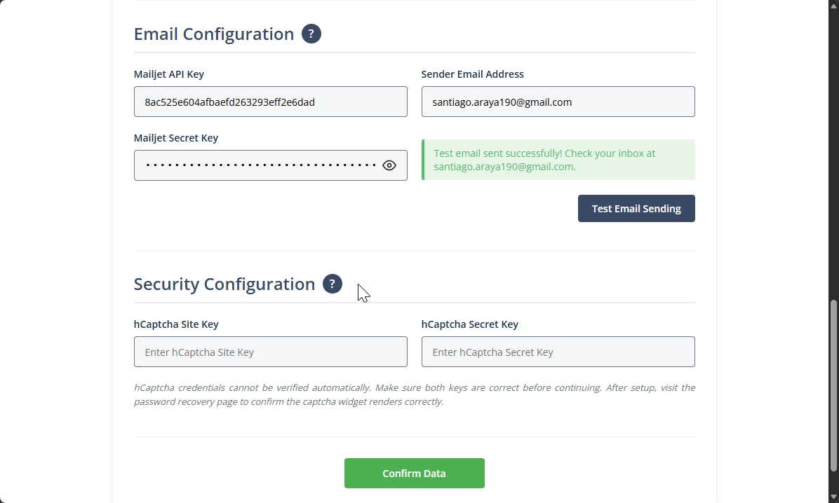
Step #6
Now, open hCaptcha and copy the credentials needed to protect the StoreIT from bots. You can use the Help button for more information. Please ensure you enter the correct data, as the app cannot verify its accuracy.

Slide 10
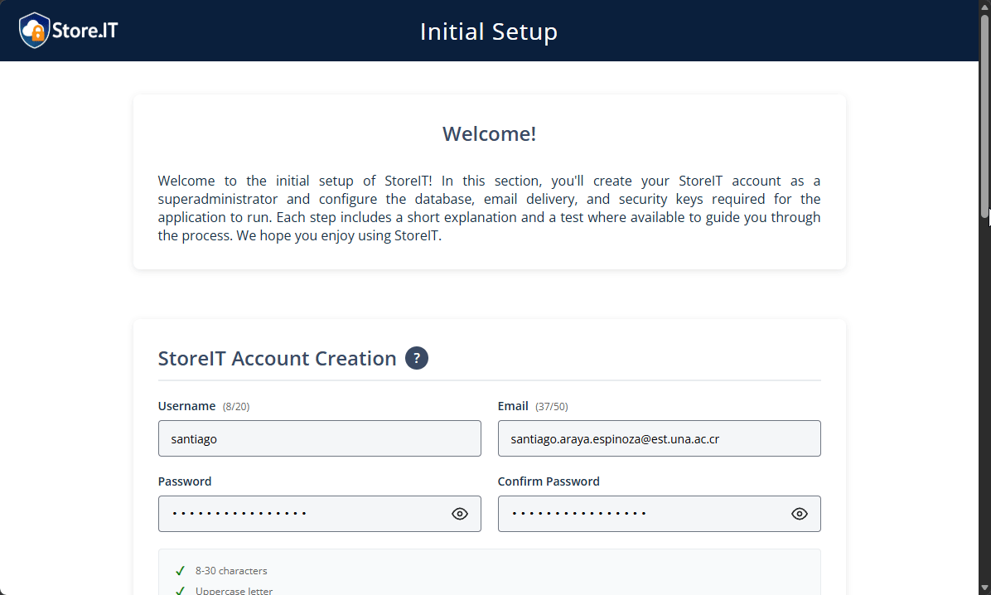
Step #7
Once you have verified that all the entered data is correct, click on the Confirm Data button. This should redirect you to the Login page, where you will see a success message indicating that the configuration was successful. From here, log in with the username and password you just created and explore all the features that StoreIT has to offer.

Slide 11
Congratulations, you have successfully completed the installation of StoreIT Web!
We hope you enjoy the app. Consult the other application manuals and/or the README.md files available in the respective repositories for more information.

